Slide 1
IBM University Engagement Project Submission
“Exploring the Power of Agentic AI with IBM Granite and IBM Bob”

Slide 2

Project Tile – Interview Trainer Agent
Domain of Project – EdTech
Student Name | Recent Passport Photo | Email ID | Mobile number [WhatsApp]
Ashwath Baskar |  | ashwath.basofficial@gmail.com | 9551708053

Slide 3
Problem Statement -
Interview Trainer Agent
The Challenge
An Interview Trainer Agent, powered by RAG (Retrieval-Augmented Generation), prepares users for job interviews by generating tailored question sets and preparation strategies based on their profile name, experience level, and job role.
The Objective
Build an AI-powered Interview Trainer Agent that delivers personalized dietary insights and guidance for individuals, families, and health professionals. The solution should:
It retrieves role-specific interview questions, industry expectations, behavioral scenarios, and HR guidelines from recruitment portals, professional networks, and company interview databases.
Users can input their resume or job title, and the agent provides targeted questions, model answers, and improvement tips.
It supports both technical and soft skill assessment, ensuring a comprehensive interview prep
experience.
This AI-driven assistant builds user confidence, sharpens responses, and increases success rates in competitive hiring environments.

Slide 4
Proposed Solution -
Interview Trainer: An AI-Powered Interview Coaching Platform
Candidates enter their target role, experience level, company, and question type: the system generates a fully personalised interview preparation pack.
Four modes of preparation in one platform:
Generate Questions: 5 focused questions (Technical, Behavioral, HR, Evaluation) with model answers and difficulty ratings. Repeated requests are served instantly from an in-memory response cache, avoiding redundant LLM calls.
Resume Analyzer: Role fit score, resume-specific questions, vulnerability areas, and a 30-day study plan. Identical resume submissions are cache-served within the session.
Answer Evaluator: Candidate writes a practice answer and receives a score out of 10, gap analysis, and a polished model answer. Cache key normalization ensures minor punctuation or spacing differences in re-submissions still resolve to a cache hit.
AI Coach Chat: Open-ended multi-turn conversation with a knowledge-grounded interview coach.
All responses grounded in the Interview_Agent vector knowledge base via IBM Watson Discovery: the model never answers from memory alone.
Built on IBM Granite (ibm/granite-4-h-small) via IBM watsonx.ai with real-time inference and IAM token authentication. A lightweight in-memory response cache with zero external dependencies intercepts repeated requests before they reach the RAG pipeline, eliminating redundant token spend across all stateless endpoints.
Most interview prep tools give generic questions. This platform reads the candidate role, level, and resume, retrieves relevant knowledge from a vector index, generates content specific to that person, and serves repeat requests instantly from cache. It functions more like a personal coach than a search engine.

Slide 5
Technology Used
IBM Bob platform -For designing and orchestrating agent workflows visually
IBM Grainte model - for eg – ibm-granite-3-2-8b – For natural language understanding, reasoning, and personalization
IBM Cloud – It provides the infrastructure to build, deploy, and scale the Interview Trainer Agent efficiently. IBM Cloud enables a reliable, secure, and scalable environment for deploying the Interview Trainer Agent.
RAG– RAG to fetch real data first, then generate intelligent answers, making the Interview Trainer Agent more trustworthy and effective.
IBM Watsonx.ai - For model deployment, embeddings, and AI governance
Vector Database (IBM watsonx (In-Memory) vector store) – For RAG-based Interview data retrieval

Slide 6
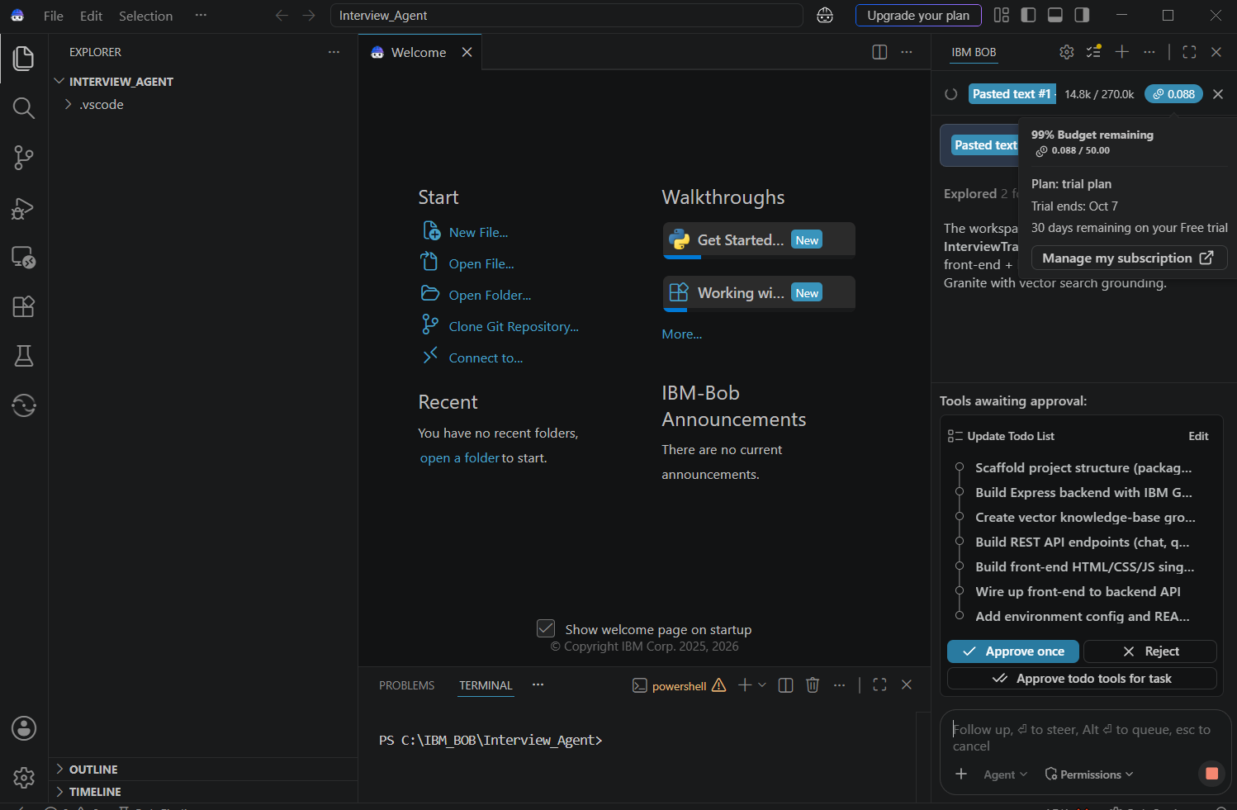
Required Files created using IBM bob -

Slide 7
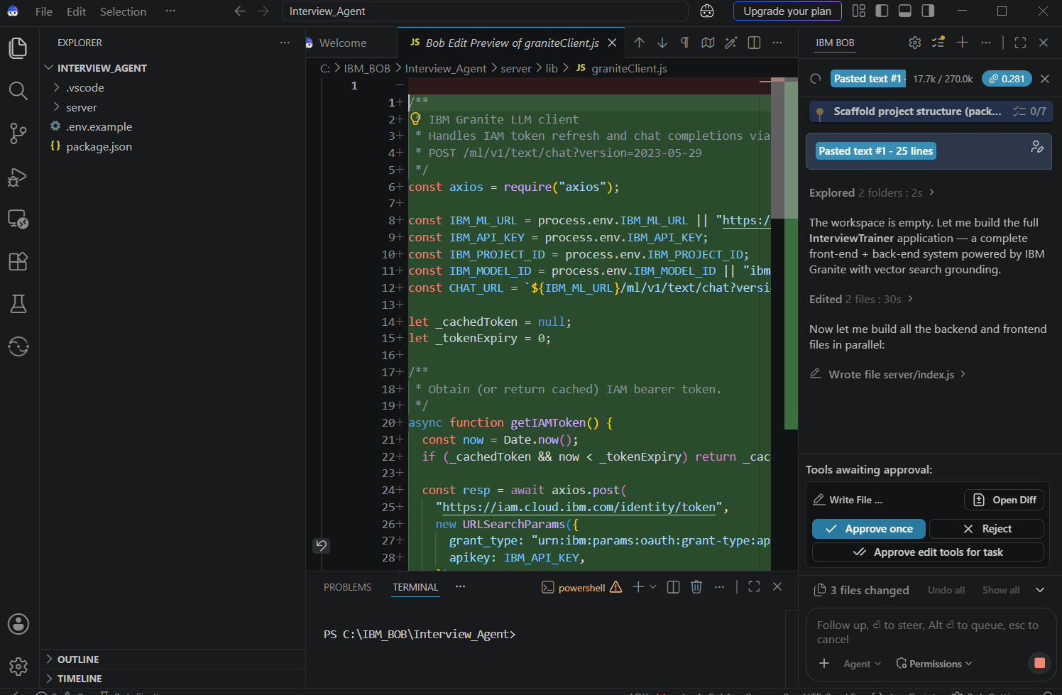
IBM Bob Screenshots:

Slide 8
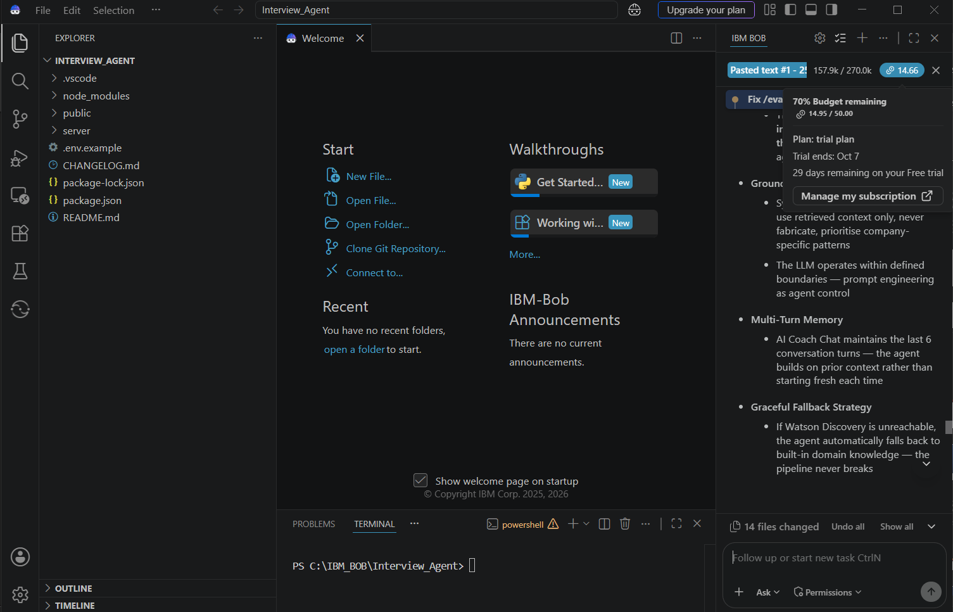

Slide 9
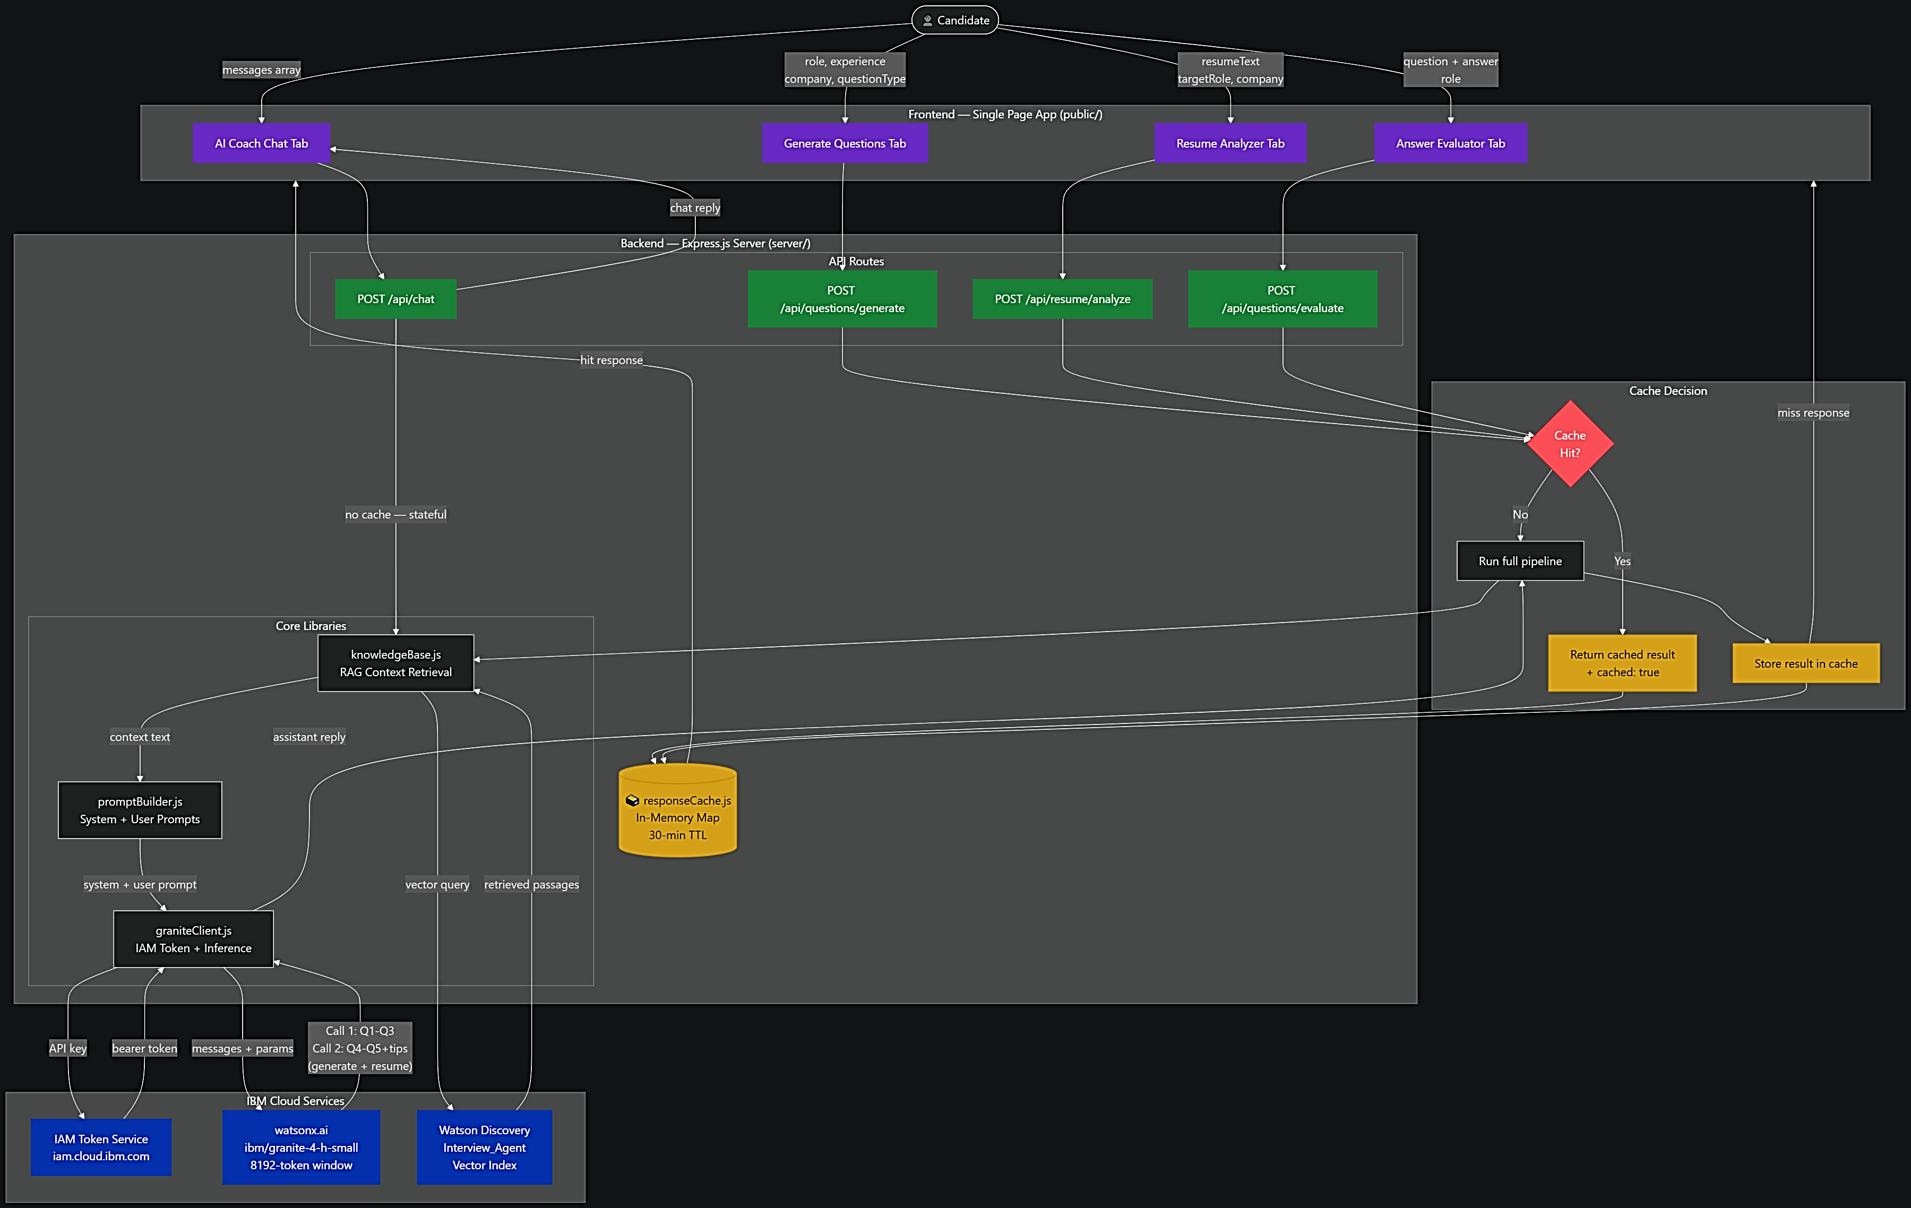
Architecture blueprint for IBM bob:
BROWSER / FRONT-END
EXPRESS SERVER (Node.js)
IBM CLOUD SERVICES

Slide 10

Role of Agentic AI in the solution
How Agentic AI Drives Interview Trainer
RAG: Retrieval-Augmented Generation Before every LLM call, the system queries the Interview_Agent Watson Discovery vector index. Retrieved passages are injected into the system prompt, ensuring the model is grounded in domain knowledge rather than free to hallucinate.
Cache-Gated Pipeline Before RAG retrieval even begins, the agent checks an in-memory response cache. On a hit, the full result is returned immediately, skipping the Discovery query, system prompt construction, and all Granite calls. The agent observes the incoming request and decides whether the pipeline needs to run at all.
Multi-Step Sequential Reasoning Chain Call 1 generates Questions 1 through 3, and the output is fed back as assistant context. Call 2 continues with Questions 4 through 5 and tips. The server observes the intermediate output and decides the next prompt, establishing the agentic loop.
Grounded Persona as Agent Controller The system prompt defines strict rules: use retrieved context only, never fabricate, and prioritise company-specific patterns. The LLM operates within defined boundaries with prompt engineering acting as agent control.
Multi-Turn Memory AI Coach Chat maintains the last 6 conversation turns, allowing the agent to build on prior context rather than starting fresh each time. Chat is intentionally excluded from caching because responses are stateful and context-dependent.
Graceful Fallback Strategy If Watson Discovery is unreachable, the agent automatically falls back to built-in domain knowledge so the pipeline never breaks.
Beyond a single prompt, the system functions as a reasoning pipeline that retrieves, observes, caches, continues, and grounds every response. The model does not pick its own tools, but it uses core building blocks including RAG for grounding, a pre-pipeline cache gate for efficiency, multi-step chaining where the output of one step feeds the next, and a controlled reasoning persona.

Slide 11
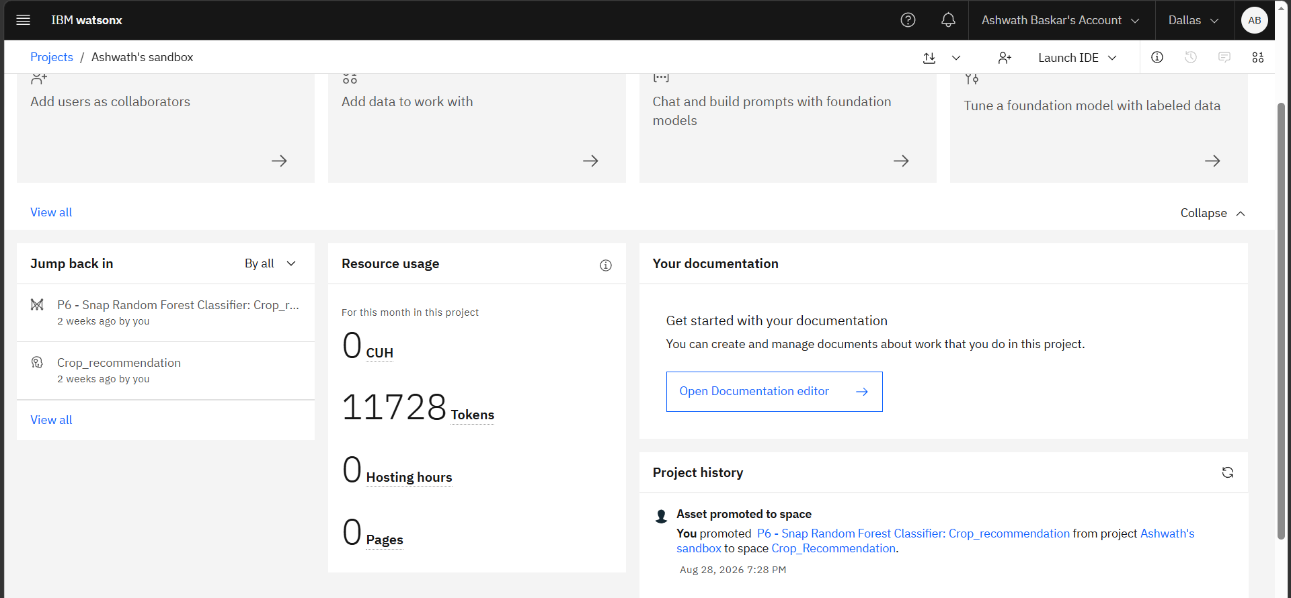
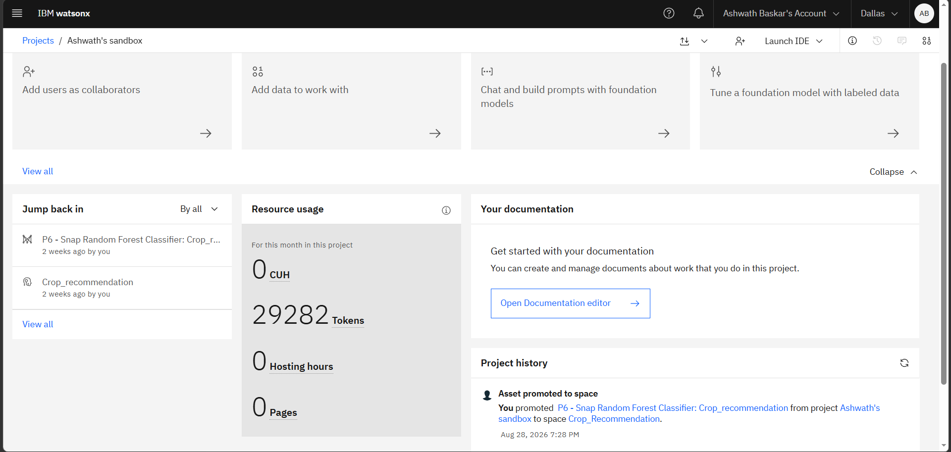
Token Usage
17,554 tokens are used
Before Prompt
After the Prompt
·
·
·

Slide 12
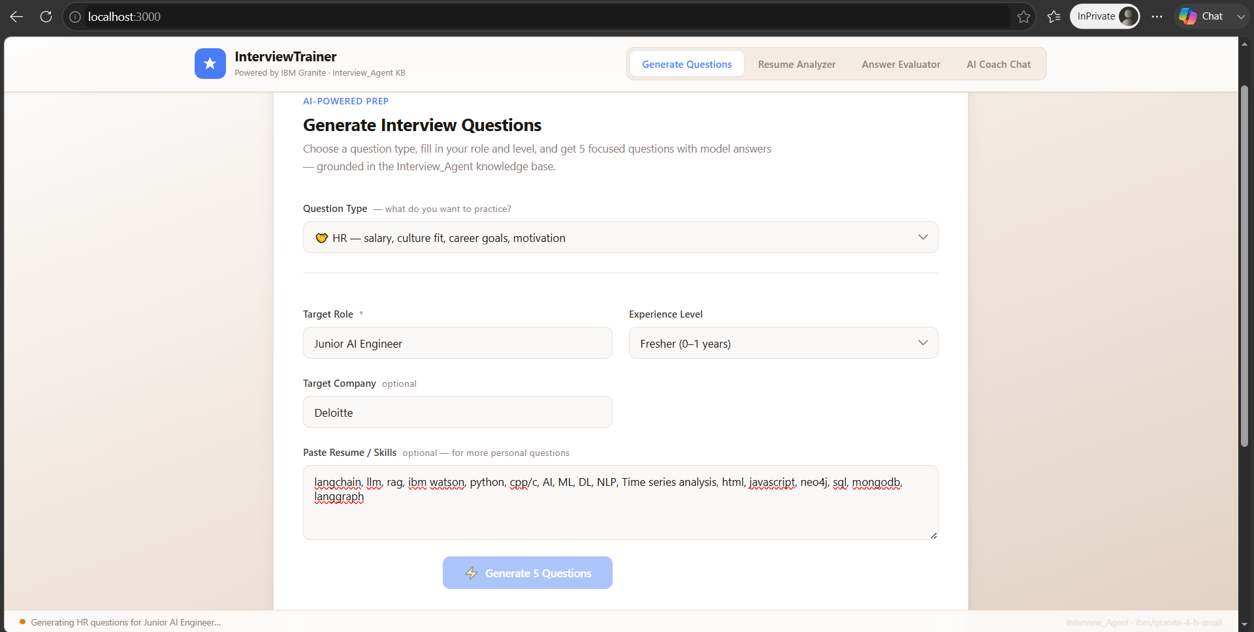
Project Output Screenshot
Please put IBM Bob output screenshots with 2-3 prompts.
You can take 2-3 more slides for each screenshot
·
·
·

Slide 13
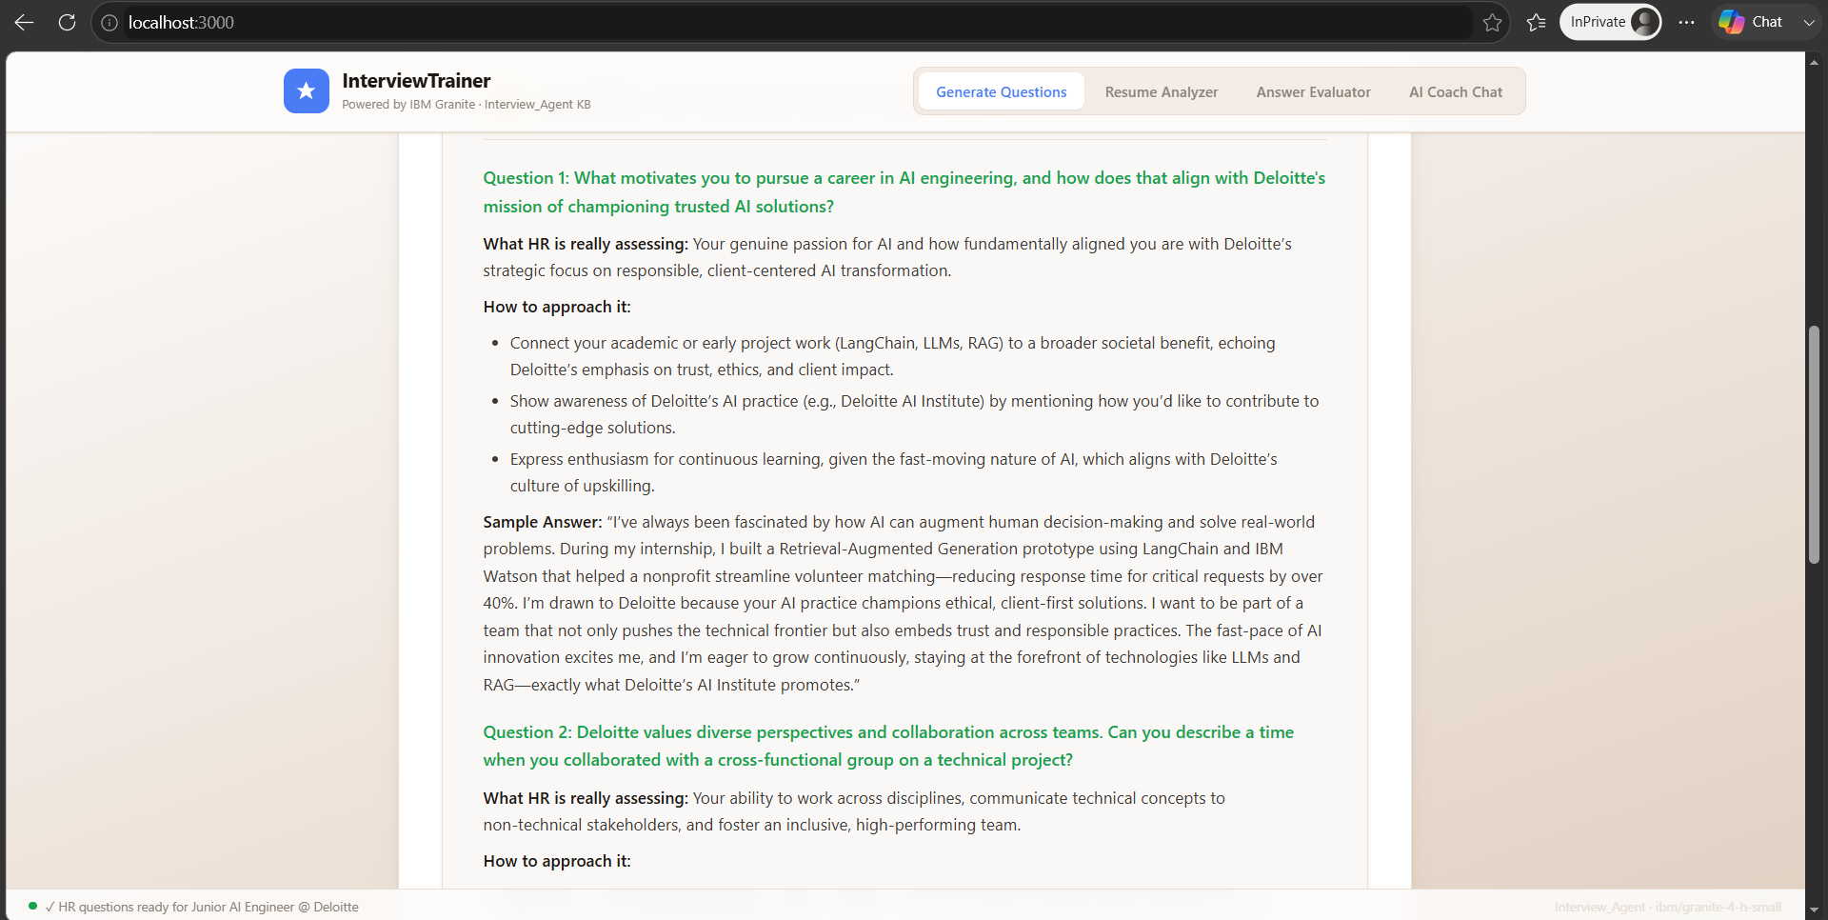
Project Output Screenshot
Please put IBM Bob output screenshots with 2-3 prompts.
You can take 2-3 more slides for each screenshot
·
·
·

Slide 14
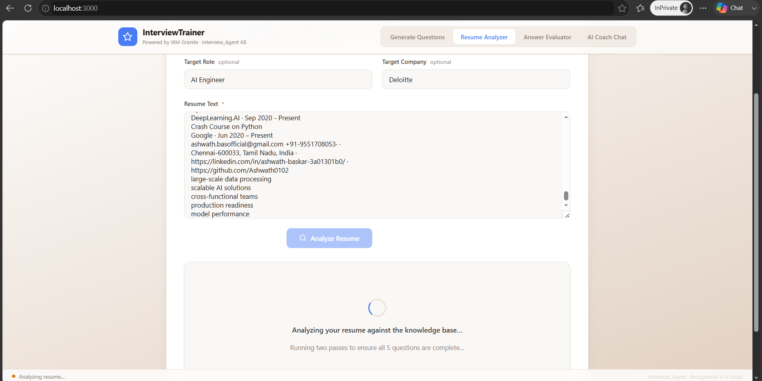
Project Output Screenshot
Please put IBM Bob output screenshots with 2-3 prompts.
You can take 2-3 more slides for each screenshot
·
·
·

Slide 15
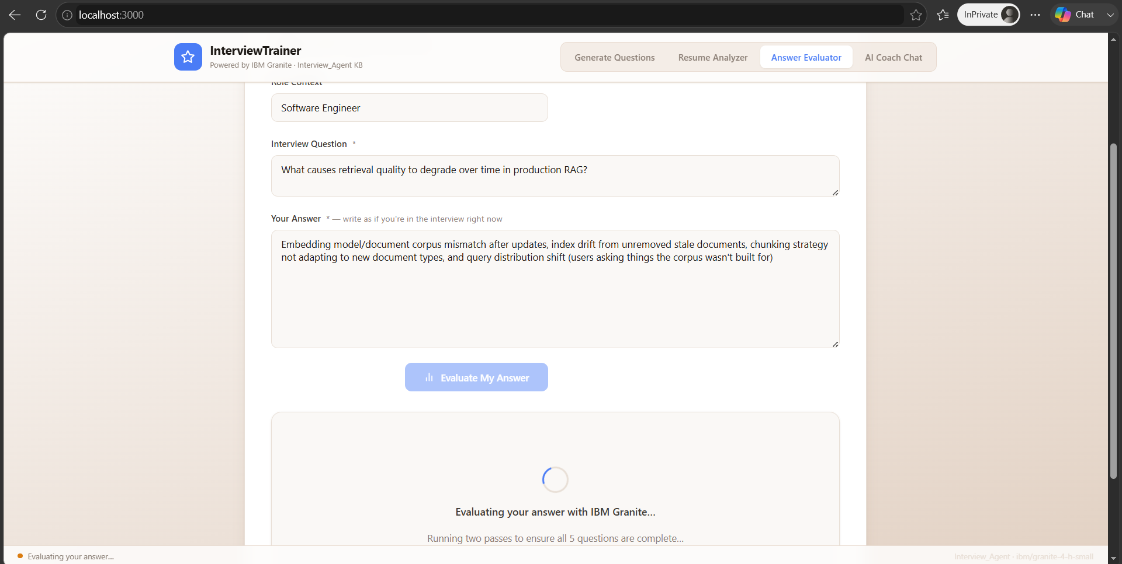
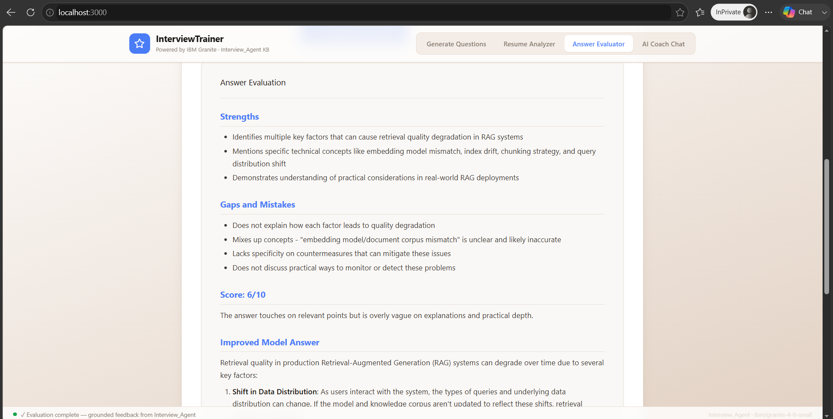
Project Output Screenshot
Please put IBM Bob output screenshots with 2-3 prompts.
You can take 2-3 more slides for each screenshot
·
·
·

Slide 16
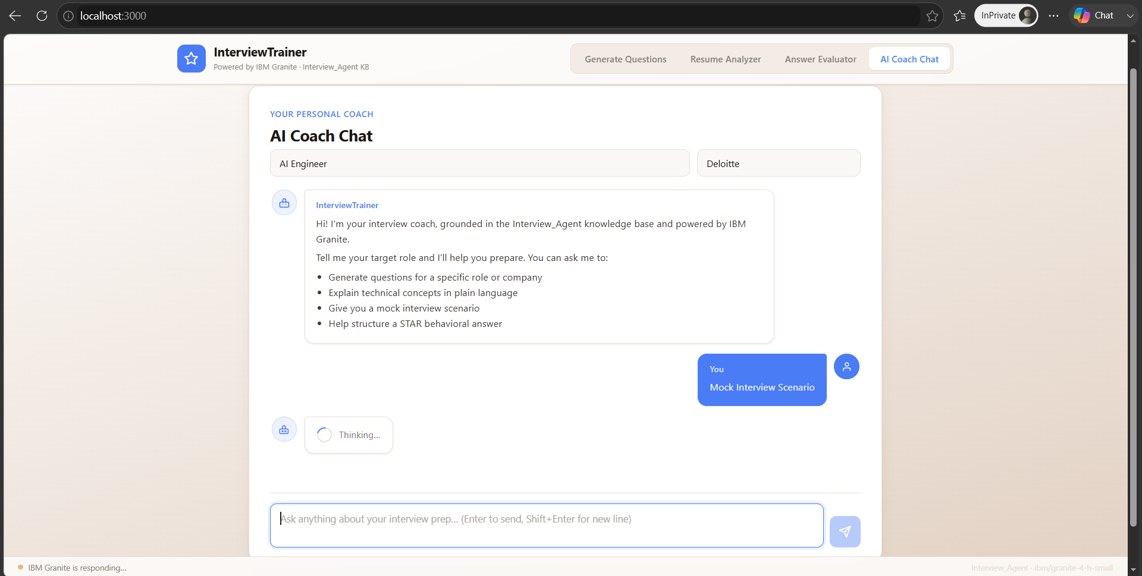
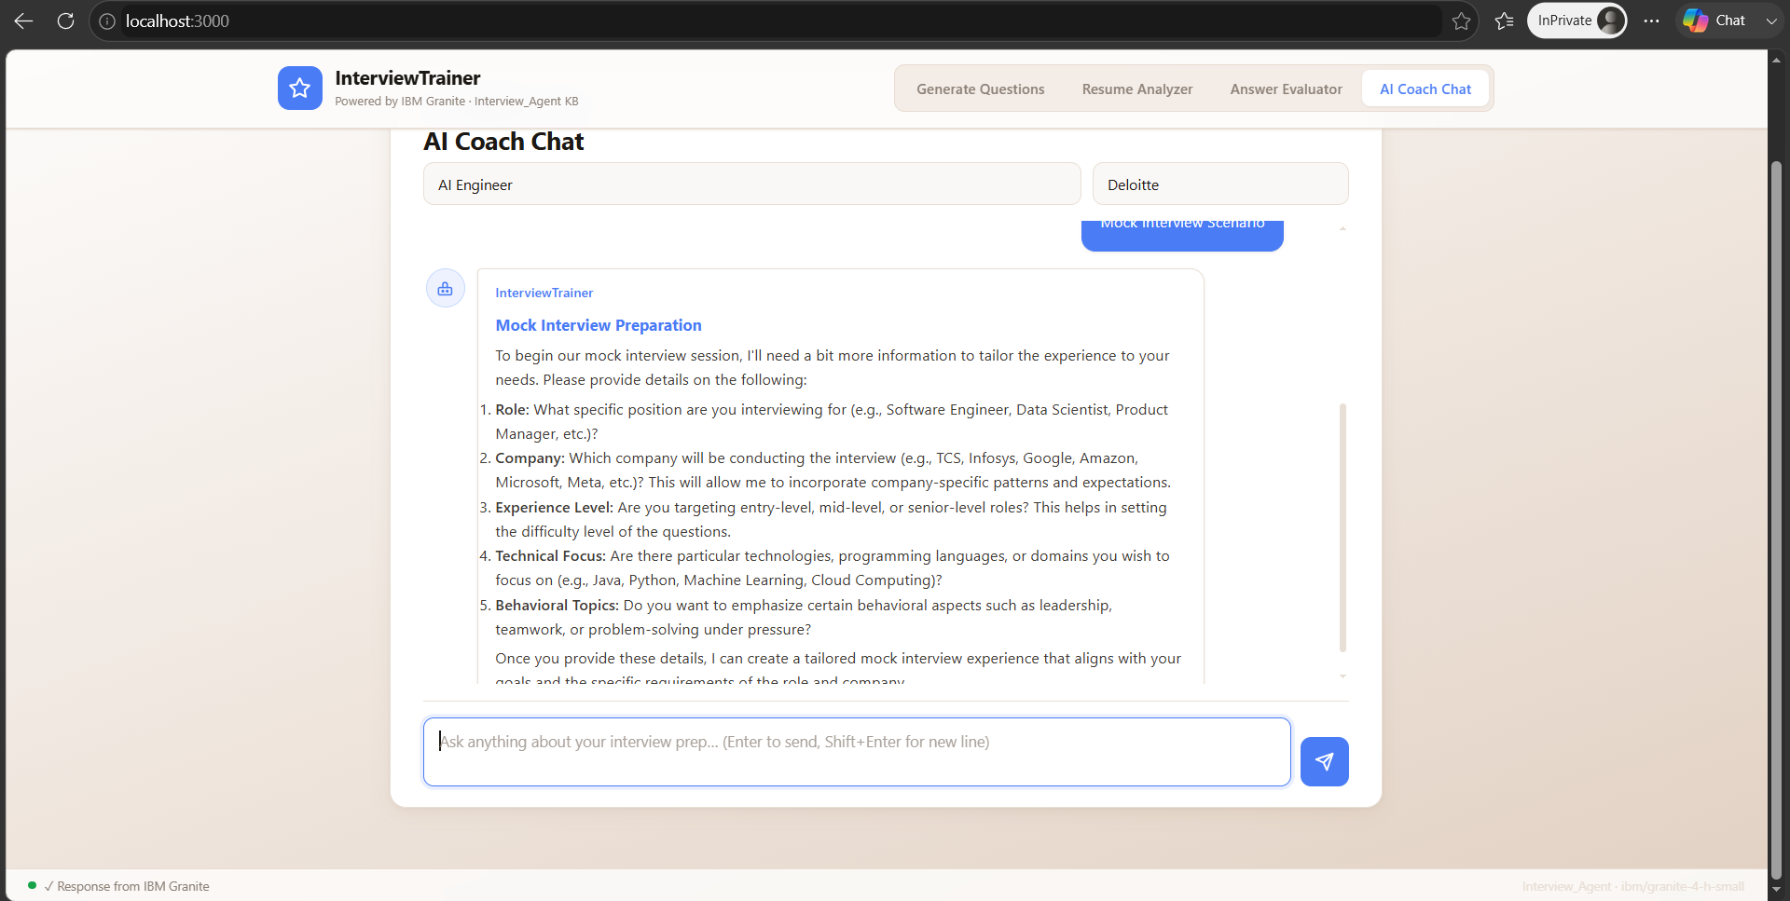
Project Output Screenshot
·
·
·

Slide 17
Novelty and Uniqueness
Not a question bank. Not a chatbot. A grounded, role-aware, multi-modal coaching system.
Question Type Separation
Separates Technical, Behavioural, HR, and Evaluation rounds: each with its own prompt template, format, and model answer structure matching how that round is actually conducted in real interviews
Resume-Aware Personalisation
Reads the candidate's resume and generates questions the interviewer will probe based on that specific background, not generic role questions
Identifies vulnerability areas the resume does not cover and builds a 30-day prep plan around those exact gaps
Two-Call Sequential Chain: Solving the Token Wall
Output of Call 1 is fed as memory to Call 2, the candidate always receives all 5 complete questions, no truncation, no mid-sentence cutoffs
A practical, production-level solution to the 8,192-token context window constraint of small LLMs
In-Memory Response Cache: Zero-Dependency Token Efficiency
A Map-backed singleton cache with no Redis, external service, or API key intercepts repeated requests before the RAG pipeline runs. Cache keys are normalized by being lowercased, whitespace-collapsed, and having trailing punctuation stripped, ensuring minor re-submission differences still resolve to a hit. This saves up to 3,600 output tokens per cache hit on generate and resume routes, with stateless endpoints cached and stateful chat intentionally excluded.
Grounded by Design
Every API call injects retrieved context before the LLM responds: outputs are verifiable and consistent, not probabilistic guesses
Full IBM Stack
End-to-end use of IBM services including IAM authentication, watsonx.ai inference, and Watson Discovery vector search. The platform uses no third-party LLM wrappers or external vector databases, operating entirely within the IBM ecosystem.

Slide 18
Git Hub Link
https://github.com/Ashwath0102/Interview-Trainer-An-AI-Powered-Interview-Coaching-Platform
·
·
·

Slide 19
Future Scope
1) Voice-Based Mock Interview Simulator
Integrate speech-to-text and text-to-speech so candidates can speak their answers aloud and receive real-time verbal feedback, simulating the actual pressure of a live interview rather than filling a text form.
2 Autonomous Multi-Round Agent with Self-Evaluation Loop
Evolve the current two-call chain into a fully autonomous agent that conducts an entire mock interview, asking a question, receiving the answer, scoring it, deciding whether to probe deeper or move on, and generating a final performance report, all without manual steps between rounds.
3) Company-Specific Live Knowledge Base
Replace static fallback knowledge with a continuously updated, company-curated vector index pulling from verified interview reports, job descriptions, and company value documents, ensuring questions and advice always align with the latest hiring patterns of organisations like Google, Deloitte, TCS, or IBM.
·
·
·

Slide 20
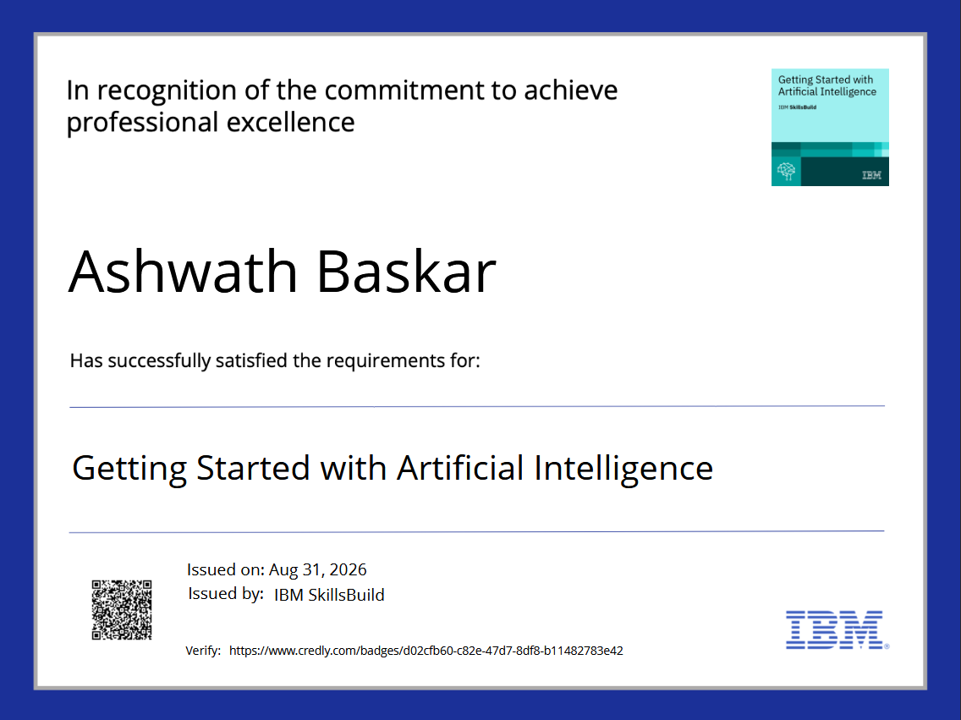
Certificates Earned:
Credly certificate(Getting Started with Artificial Intelligence)

Slide 21
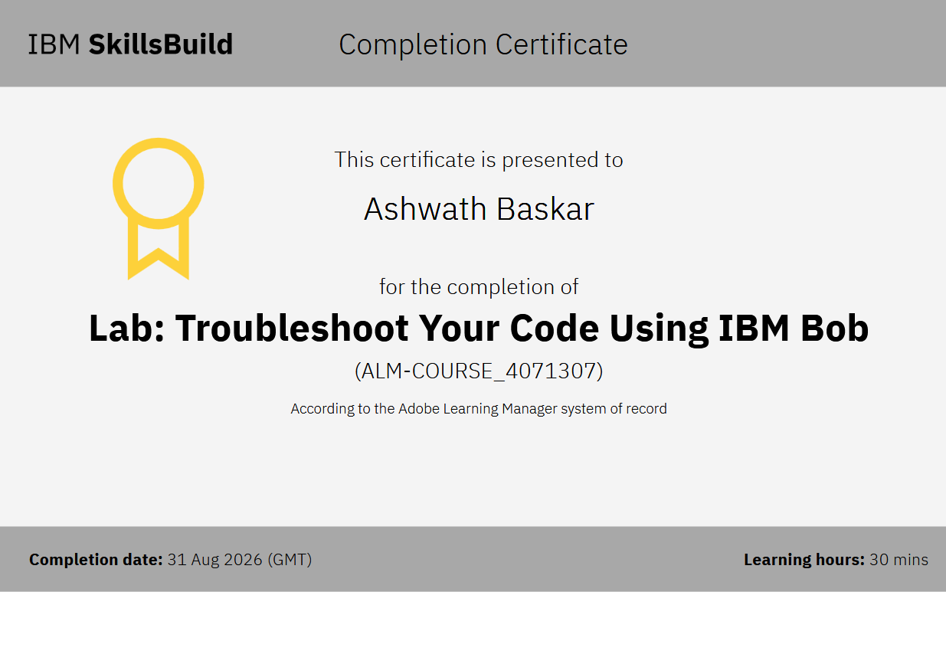
Certificates Earned:​
IBM BOB Certificate

Slide 22


